Slide 1
A Minor Project on Face Detection & Recognition
Deepa Bhandari 14/336
Rohan Baidya 14/335
Deepak Pd. Shah 14/328
Punita Kushwaha 14/316

Slide 2
Introduction
Face Detection and Recognition (FDR) consists of three basic steps:
Face Detection : that identifies face like pattern in a space
Face Feature Extraction : that extracts the facial features (landmarks)
Face Recognition : that gives the probability of the face match

Slide 3
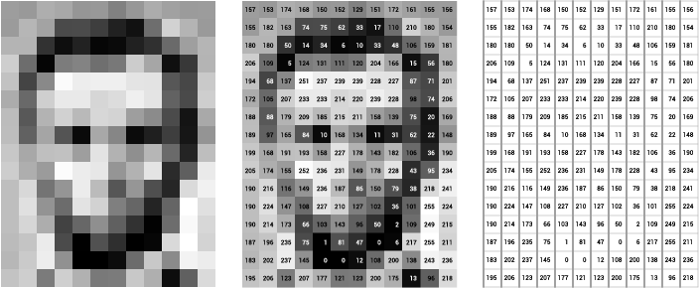
Overview

Slide 4
Image Classifier
Classifiers are used to analyze and categorize all pixels in a digital image into one of several land cover classes, or "themes".
Multispectral data perform classification, and the pattern in data is used for each pixel’s numerical value as basis for categorization.
The objective of image classification is to identify and portray, as a unique gray level (or color) of the features occurring in an image.

Slide 5
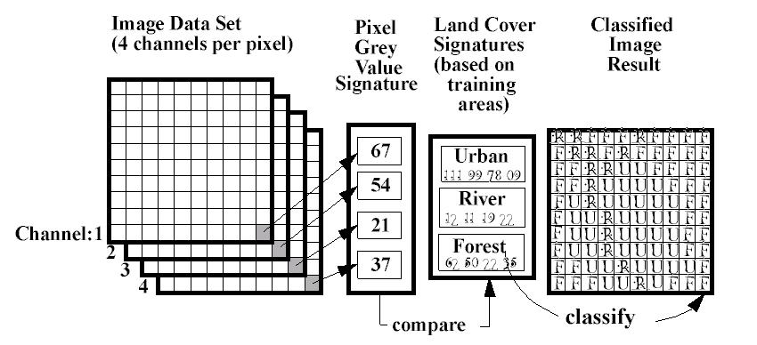
Image Classification

Slide 6
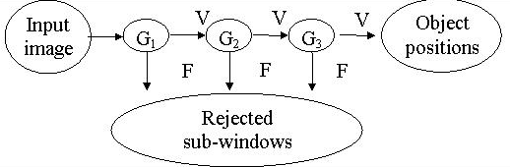
Cascade Classifier
Selects small number of critical visual features
Combines Weak Classifier to form Strong Classifiers
Stages are created using Ada Boost (Adaptive Boosting)

Slide 7
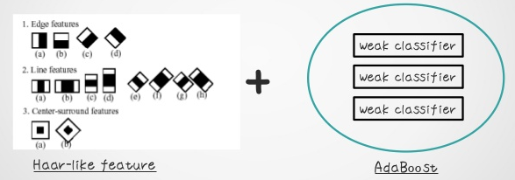
Haar - Cascade Classifier

Slide 8
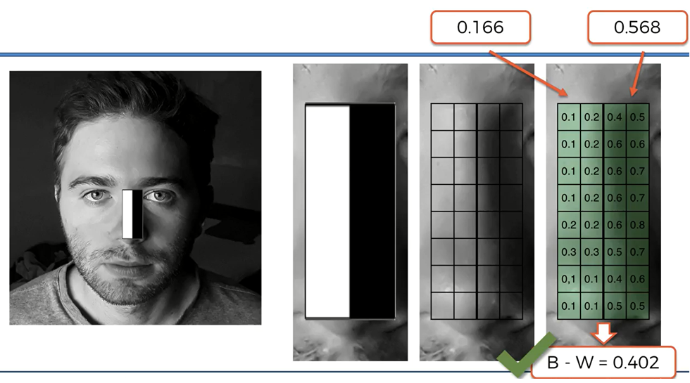
Haar – Like Feature

Slide 9
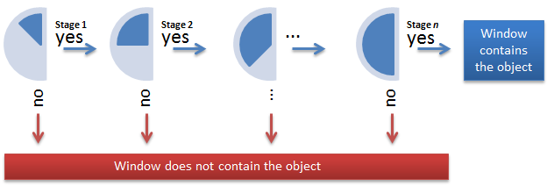
Ada – Boosting

Slide 10
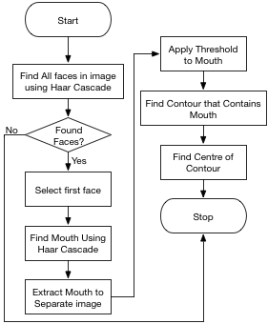
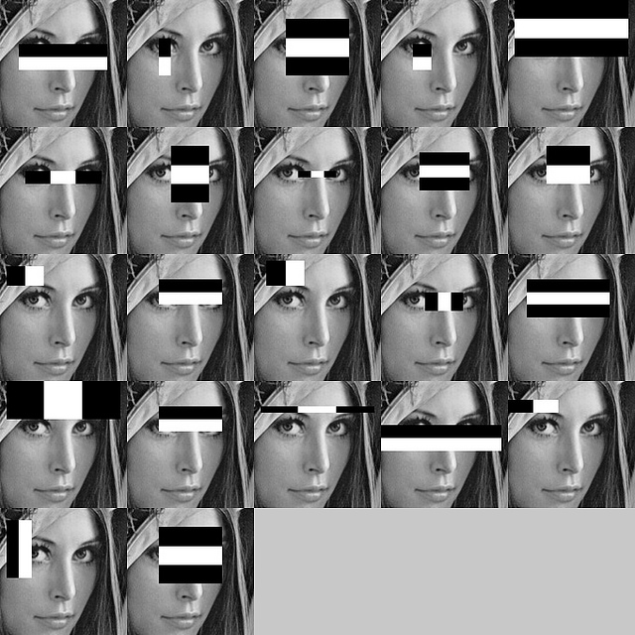
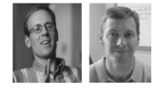
Viola – Jones Algorithm
ROBUTS
QUICK (x15)
ACCURATE (95%)

Slide 11
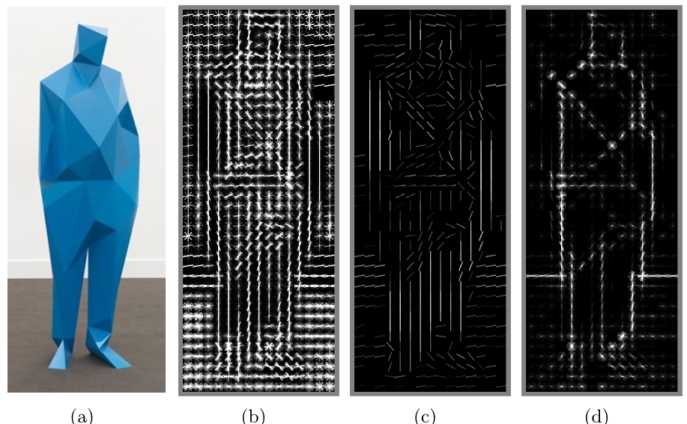
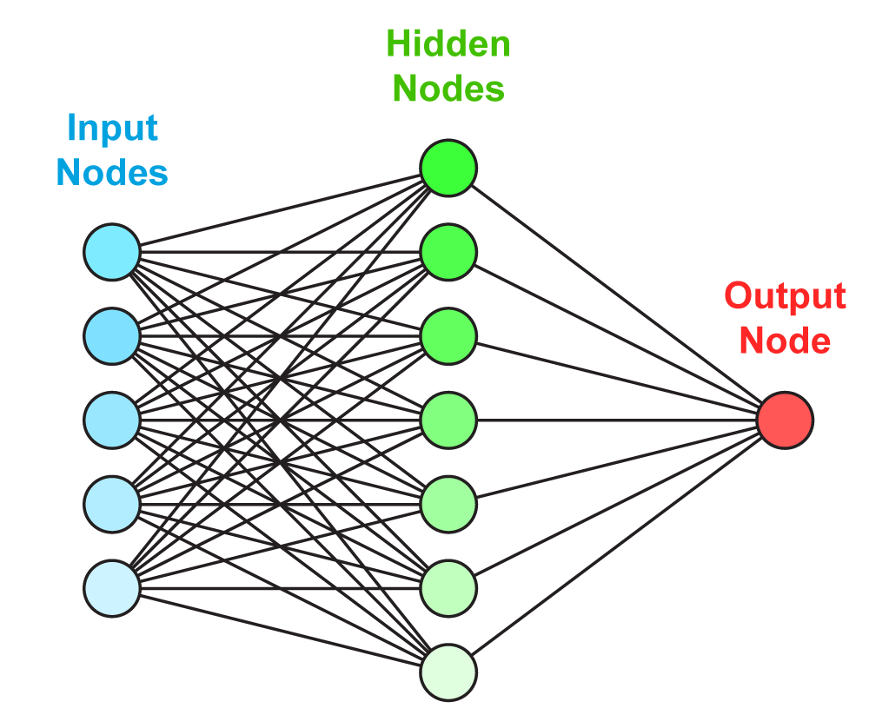
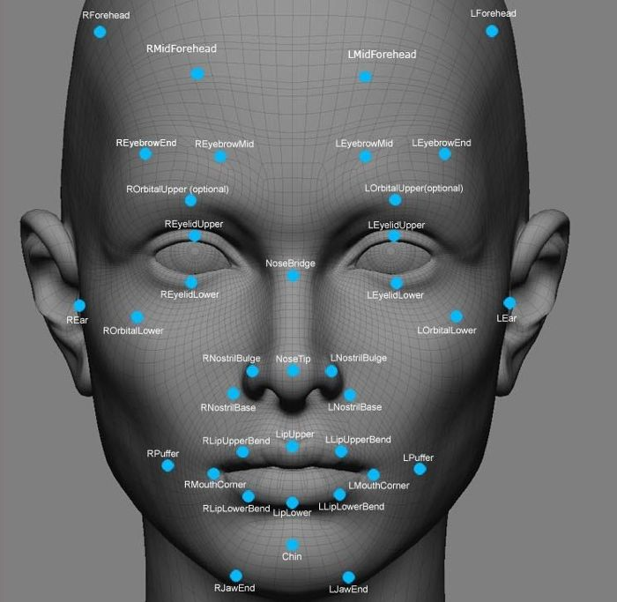
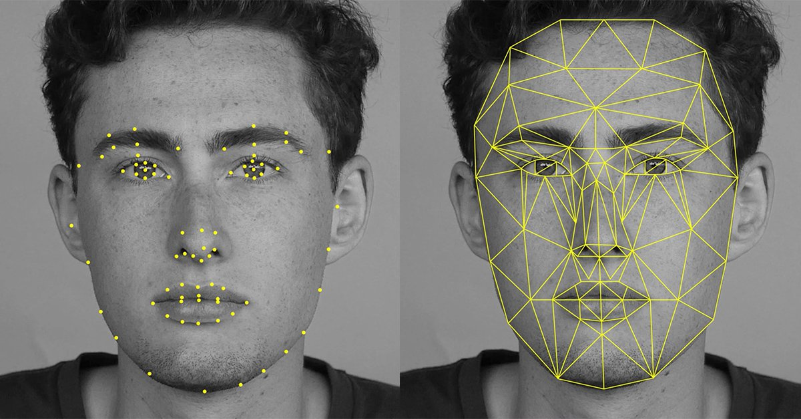


Other Methods …

Slide 12
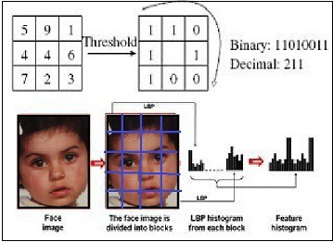
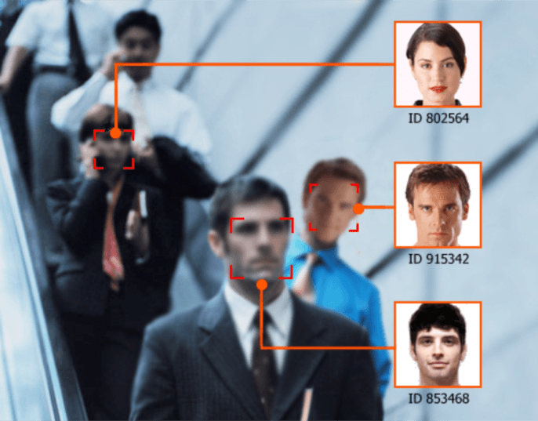
Face Matching and Prediction

Slide 13
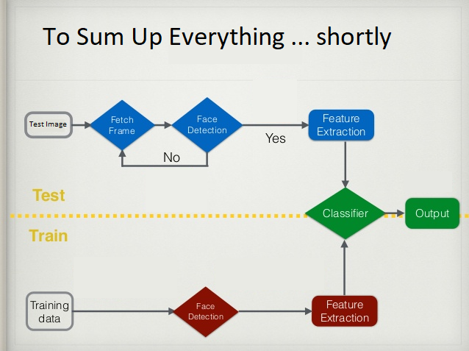

Slide 14




Platform
Open CV 3.2
Python 2.7 (IDLE)
Numpy
Pillow
Image
SQLite3

Slide 15
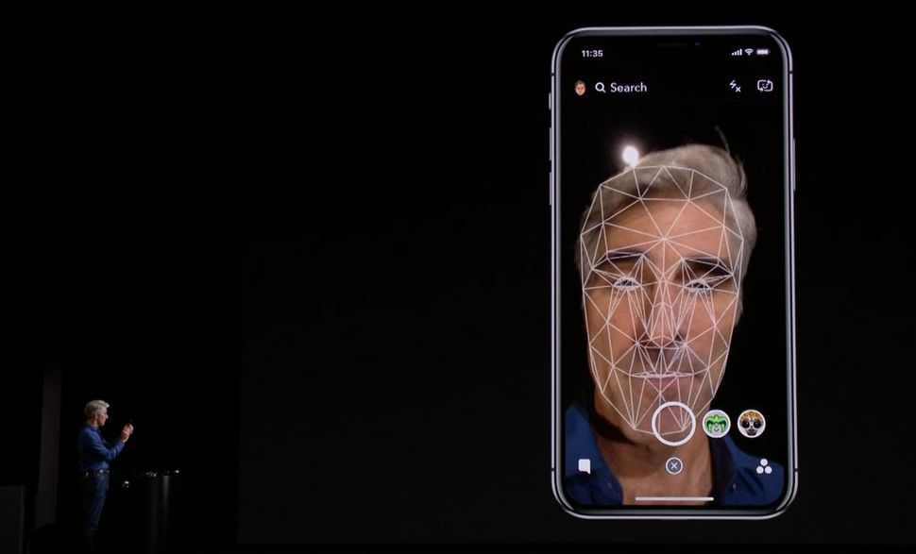

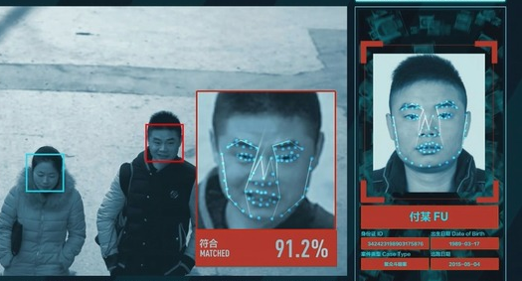
Application Areas
Enhance Security Measures
Permit Authorize Access
Intelligence Agency
Forensic and Medical Diagnosis

Slide 16
Reference
https://www.docs.opencv.org/2.4/modules/contrib/doc/facerec/facerec_tutorial.html [site visited on: 4th October, 2017]
https://docs.opencv.org/trunk/d7/d8b/tutorial_py_face_detection.html [site visited on: 20th October, 2017]
https://thecodacus.com/opencv-python-face-detection/#.WpGxtExuJuk [site visited on: 19th January, 2017]

